Slide 1
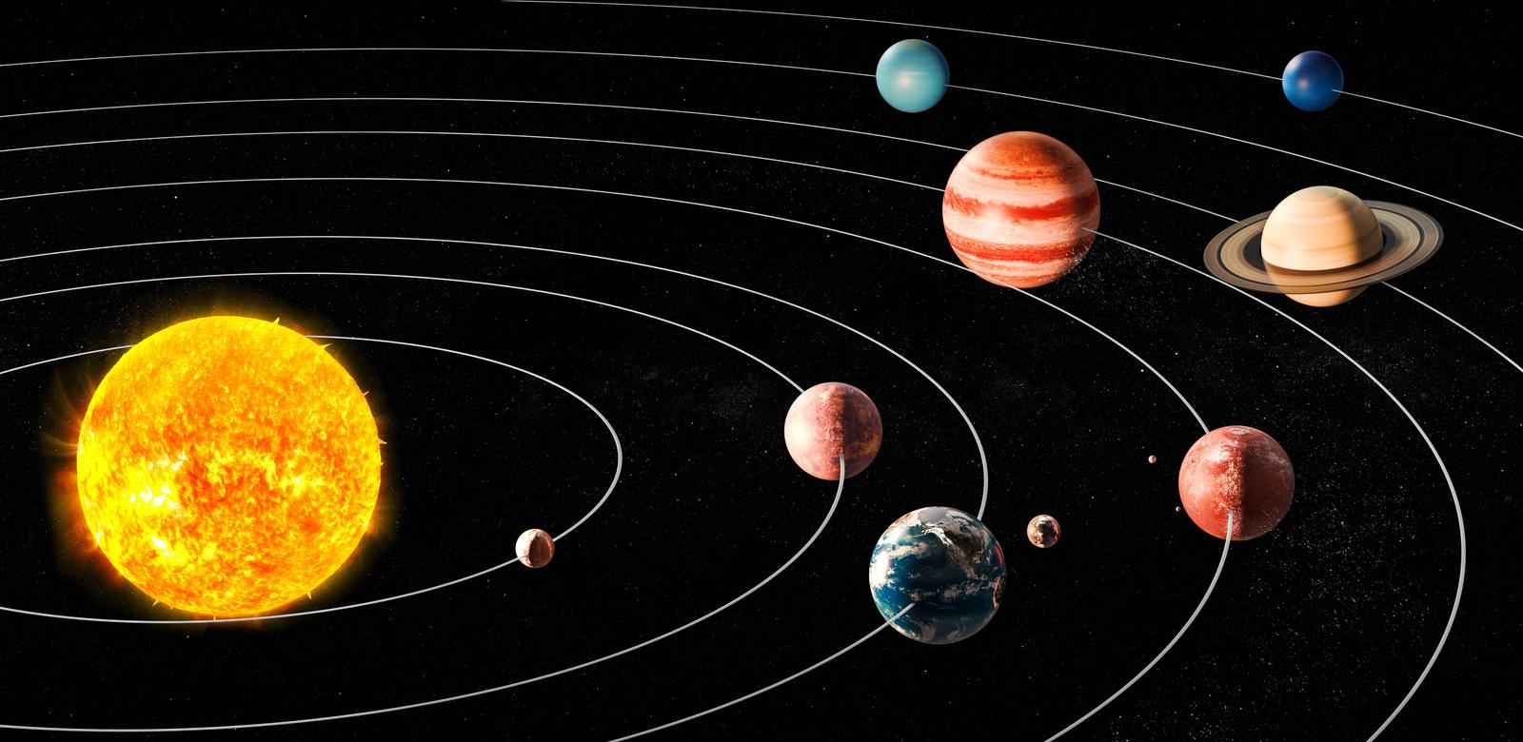
🪐
Lesson 1: Solar System Animation - Learning Objectives
1
Create smooth orbital animations using paths and forever loops Use parallel processing to make multiple objects move simultaneously Apply realistic timing so closer planets move faster than distant ones
Key Concepts:
• Paths
• Forever Loops
• Parallel Processing

Slide 3
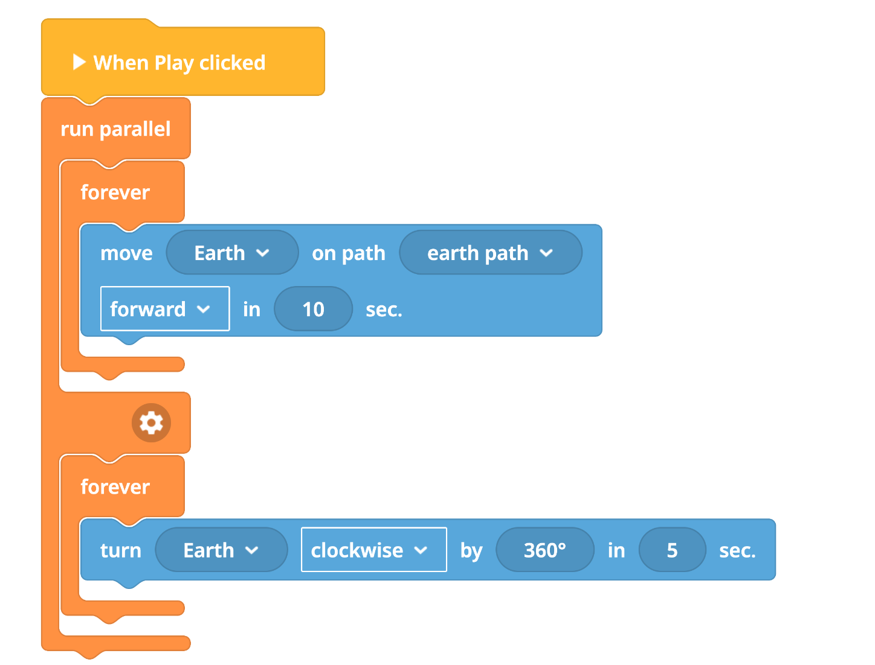
💻
Lesson 1: Code Structure
when play clicked run parallel
forever
move Earth on path earth_path forward in 10 sec
run parallel
forever
move Moon on path moon_path forward in 3 sec
Building Your Animation:
1. Create circular paths for each object
2. Set different durations (closer planets = shorter times) 3. Use "run parallel" so all objects move at once

Slide 4
✅
Lesson 1: Mini Plenary
⭐
Check Your Progress:
Do your planets move continuously without stopping? Are closer planets moving faster than distant ones? What happens if you change the duration numbers?
Discuss with your partner what you've learned!

Slide 5
Lesson 1: Challenge Levels
🥉
Foundation
🥈
Intermediate
🥇
Advanced
Inner solar system (5-6 planets)
• Add Mercury, Venus, Mars
• Increase speed of each planet
Success: Realistic speed relationships
Full solar system + rotation
• All 8 planets with research
• Add planet rotation blocks
Success: Complex animation system
Sun-Earth-Moon system (3 objects)
• Simple circular paths around the sun
• Earth orbits sun, Moon orbits Earth
Success: Smooth continuous movement

Slide 6
Lesson 1: Plenary
🌟
🌟
Today you mastered paths and forever loops to create realistic solar systems!
What We Achieved:
Created smooth orbital animations Used parallel processing for multiple objects Applied realistic timing relationships
🚀
Next lesson: Controlling objects with buttons and creating smart on/off systems!

Slide 7
Lesson 1: Exit Ticket
Before you leave, think about:
1. One thing you learned: _________________________________ 2. One thing you found challenging: _________________________________ 3. One question you still have: _________________________________

